Slide 1


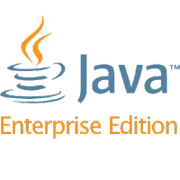
Introduction to Java EE
Java Platform, Java EE, Servlets
SoftUni Team
Technical Trainers
Software University
http://softuni.bg
Notes:
© Software University Foundation – http://softuni.org
This work is licensed under the Creative Commons Attribution-NonCommercial-ShareAlike license.
<number>

Slide 2
Table of Contents
Java Platform
Java Enterprise Edition
Apache TomEE
Context & Dependency Injection
Java Servlets
<number>
Notes:
© Software University Foundation – http://softuni.org
This work is licensed under the Creative Commons Attribution-NonCommercial-ShareAlike license.
<number>

Slide 3
Questions
sli.do #java-web

Slide 4
Java Platform
The Big Picture
Notes:
<number>
© Software University Foundation – http://softuni.org
This work is licensed under the Creative Commons Attribution-NonCommercial-ShareAlike license.

Slide 5



Java - The Big Picture
The Java Technology is both a programming language and a
platform
The Java programming language:
Object-oriented
C-like syntax
The Java platform:
Environment
Where Java applications run
<number>

Slide 6
Java - The Big Picture (2)
There are 4 Java platforms:
Java SE (Standard Edition)
Java ME (Micro Edition)
Java FX (Effects)
Java EE (Enterprise Edition)
<number>

Slide 7
Java - The Big Picture (3)
Each Java platform:
Provides a JVM & an API
Runs applications on any compatible system
Is completely independent
Provides all of the advantages of the
Java programming language
Java SE
Java ME
Java FX
Java EE
<number>

Slide 8
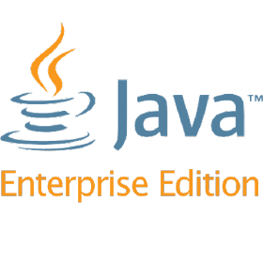
Java Enterprise Edition
Diving into the depths of Java EE
Notes:
<number>
© Software University Foundation – http://softuni.org
This work is licensed under the Creative Commons Attribution-NonCommercial-ShareAlike license.

Slide 9


Java Platform, Enterprise Edition
Java EE
Formerly (J2EE), Currently Jakarta EE
A set of specifications extending Java SE
Defined by its specification
Defines APIs and their interactions
Used in various contexts, including:
E-commerce, Accounting, Banking Systems, etc.

Slide 10


Java EE vs Java SE
Java SE
Provides APIs to handle collections
JVM is the container for Applications
The container provides lower-level services
Java ЕE
Provides APIs to handle transactions, persistence, security, messaging, etc.
Applications are ran on a specific container
The container provides higher-level services
<number>

Slide 11

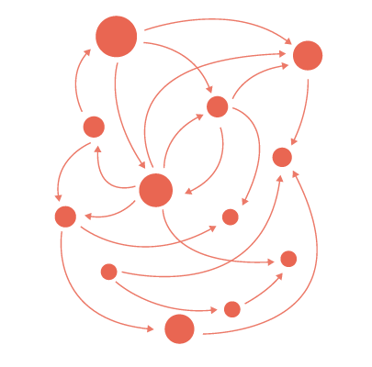

Java EE simplifies
Enterprise Applications:
Have powerful functionalities
Tend to be heavy and complex
Java EE reduces complexity
Provides a programming model
Provides a Runtime environment
Provides various APIs
<number>

Slide 12





Java EE Architecture
Container
Services
Provides
Provides
Managing
Deployment
Consumed by
Packaging
APIs
Applications
<number>

Slide 13

Maven Dependencies
pom.xml
<dependency>
<groupId>javax</groupId>
<artifactId>javaee-api</artifactId>
<version>8.0</version>
</dependency>
<number>

Slide 14

Java Community Process
The JCP is the mechanism for developing standard technical
specifications for Java technology.
https://jcp.org/en/home/index
<number>

Slide 15

Apache TomEE
Notes:
<number>
© Software University Foundation – http://softuni.org
This work is licensed under the Creative Commons Attribution-NonCommercial-ShareAlike license.

Slide 16




What is a Apache TomEE?(1)
Apache TomEE (pronounced "Tommy") is the Java Enterprise Edition of Apache Tomcat (Tomcat + Java EE = TomEE) .
Developed by the Apache Software Foundation
<number>
Notes:
© Software University Foundation – http://softuni.org
This work is licensed under the Creative Commons Attribution-NonCommercial-ShareAlike license.
<number>

Slide 17

What is a Apache TomEE?(2)
Combines several Java enterprise projects including:
Apache OpenEJB(Enterprise JavaBeans):
An open source, embeddable and lightweight EJB Container
System and EJB Server.
Has been integrated with Java EE application servers such as
Geronimo and WebObjects.
<number>

Slide 18

What is a Apache TomEE?(3)
Apache OpenJPA:
An open source implementation of the Java Persistence API
specification.
It is an object-relational mapping(ORM) solution for the Java
language, which simplifies storing objects in databases.
<number>

Slide 19

What is a Apache TomEE?(4)
Apache MyFaces:
An Apache Software Foundation project that creates and
maintains an open-source JavaServer Faces implementation,
along with several libraries of JSF components that can be
deployed on the core implementation.
<number>

Slide 20
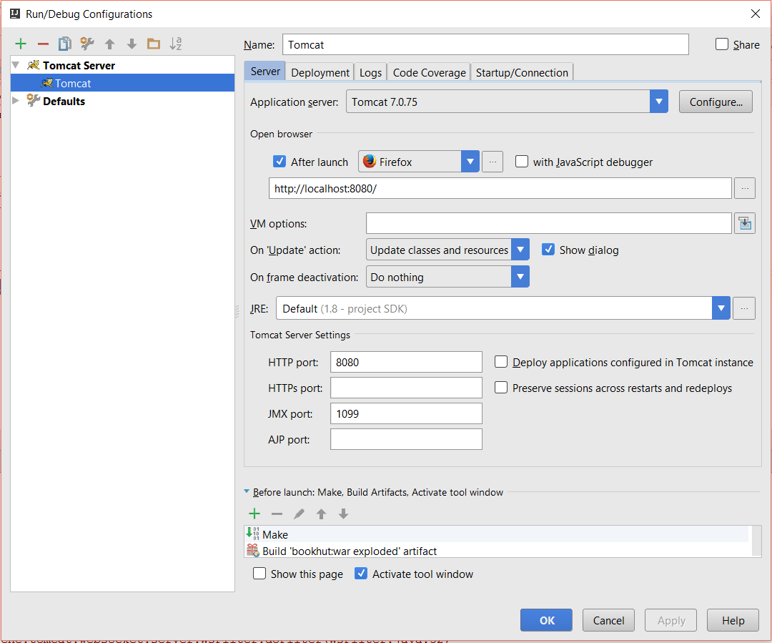

Tomcat Setup
Add Tomcat
Tomcat Server
URL
Default Action
HTTP Port
<number>

Slide 21
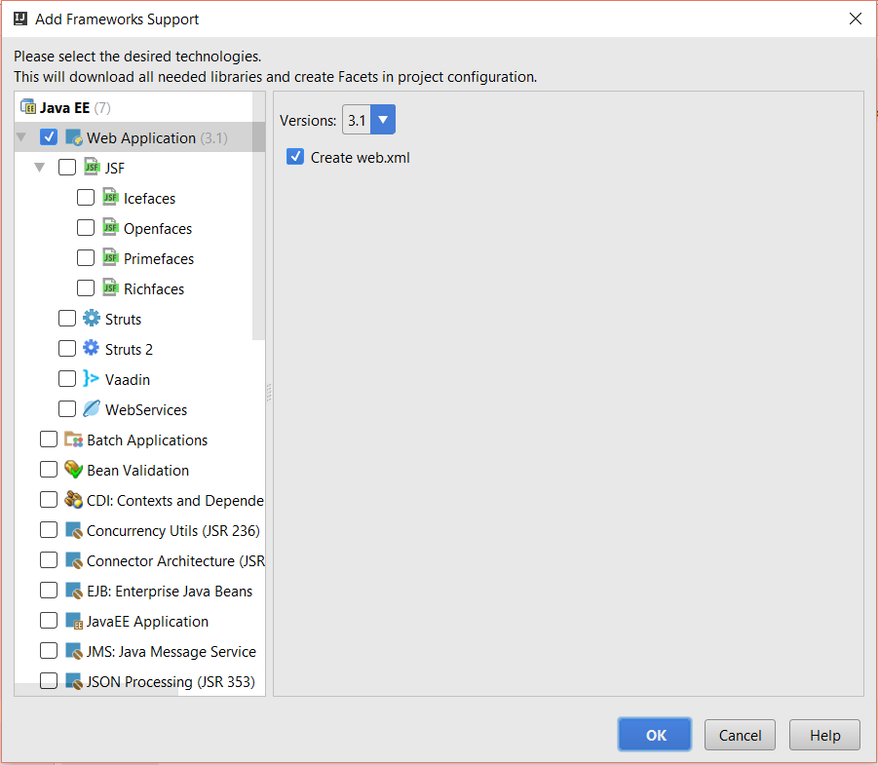
Java EE Support
Web Support
Web XML
<number>

Slide 22
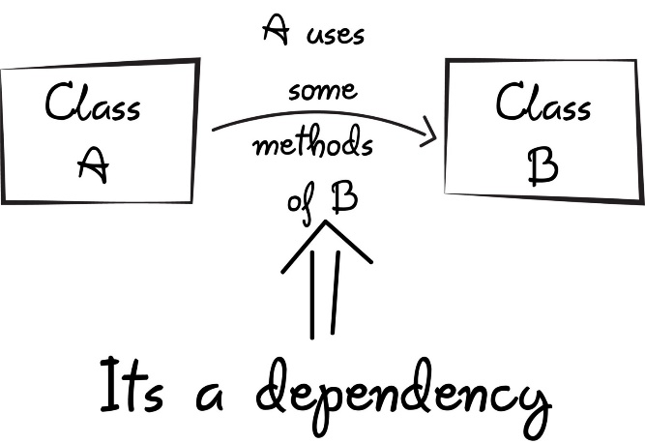
Context & Dependency Injection
<number>

Slide 23
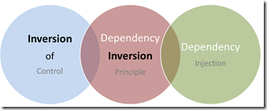
CDI(1)
CDI, or Context & Dependency Injection:
Key Java EE specification
Triggered when components are packaged
Bean Manager:
Discovers these components
Spots the dependencies between them
Injects the right reference into the right beans

Slide 24

CDI(2)
After deployment:
All beans are connected
CDI Bean:
Just an object
Managed by the bean manager
<number>

Slide 25

Java Servlets
Notes:
<number>
© Software University Foundation – http://softuni.org
This work is licensed under the Creative Commons Attribution-NonCommercial-ShareAlike license.

Slide 26
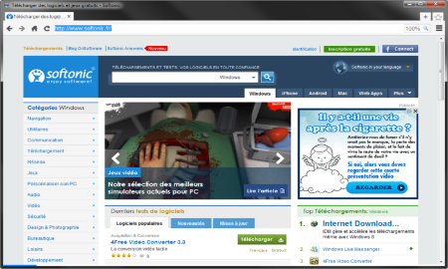
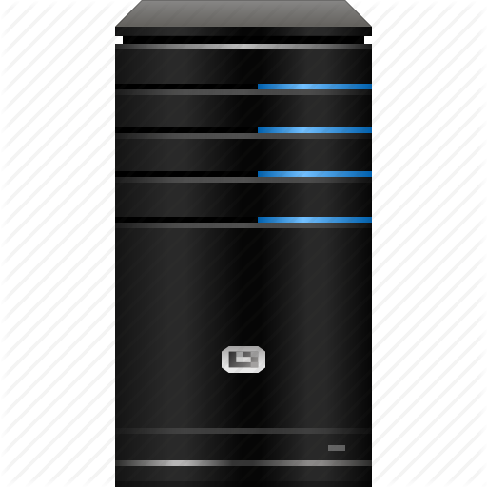




Java Servlets
Programs that run on a Web/Application server
Extend the capabilities of a Server
Able to respond to any type of request
Web Client
Web Server
Request
Request
Servlet
Database
Data
Response
Response
<number>
Notes:
© Software University Foundation – http://softuni.org
This work is licensed under the Creative Commons Attribution-NonCommercial-ShareAlike license.
<number>

Slide 27
Servlet Example
Servlet.java
URL pattern
@WebServlet("/home")
public class Servlet extends HttpServlet {
protected void doPost(HttpServletRequest request,
HttpServletResponse response)
throws ServletException, IOException {
}
protected void doGet(HttpServletRequest request,
HttpServletResponse response)
throws ServletException, IOException {
}
}
Handle Post requests
Handle Get requests
<number>

Slide 28
Servlet Lifecycle
Java Virtual Machine
Web Server
Servlet Container
Thread 1
init()
Thread 2
service()
Thread 3
destroyed()
Requests
<number>

Slide 29
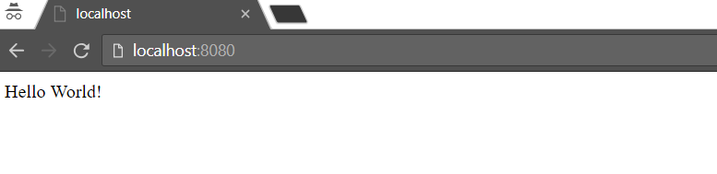
Hello World!
Servlet.java
@WebServlet("/")
public class Servlet extends HttpServlet {
protected void doGet(…) {
PrintWriter out = response.getWriter();
out.println("Hello World!");
}
}
<number>

Slide 30
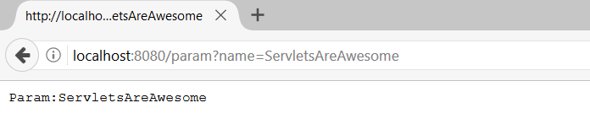
Read Parameter
Servlet.java
@WebServlet("/param")
public class Servlet extends HttpServlet {
protected void doGet(…) {
PrintWriter out = response.getWriter();
String name = request.getParameter("name");
out.println("Param:" + name);
}
}
Param name
Param name
<number>

Slide 31
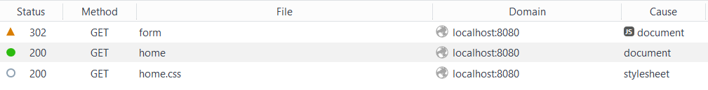
Redirect
Servlet.java
@WebServlet("/form")
public class Servlet extends HttpServlet {
protected void doGet(…) {
response.sendRedirect("/home"); }
}
Redirect to /home
<number>
Notes:
It is possible to invalidate a cookie by invoking the method languageCookie.setMaxAge(0);
© Software University Foundation – http://softuni.org
This work is licensed under the Creative Commons Attribution-NonCommercial-ShareAlike license.
<number>

Slide 32
Inject Beans(1)
beans.xml
<?xml version="1.0" encoding="UTF-8"?>
<beans
xmlns="http://xmlns.jcp.org/xml/ns/javaee"
xmlns:xsi="http://www.w3.org/2001/XMLSchema-instance"
xsi:schemaLocation="http://xmlns.jcp.org/xml/ns/javaee
http://xmlns.jcp.org/xml/ns/javaee/beans_1_1.xsd"
bean-discovery-mode="all">
</beans>
<number>

Slide 33
Inject Beans(2)
Servlet.java
@WebServlet("/")
public class Servlet extends HttpServlet {
@Inject
private UserService userService;
protected void doGet(…) {
PrintWriter out = response.getWriter();
User user = this.userService
.getUserByUsername(request.getParameter("name"));
out.println(“User:" + user.getName());
}
}
<number>

Slide 34



Summary
The Java Technology:
A platform and a programming language
Java EE – The Big Picture:
The Java EE Architecture
What is Apache TomEE?
What is CDI?
What are Servlets?
<number>

Slide 35
https://softuni.bg/trainings/courses
Notes:
© Software University Foundation – http://softuni.org
This work is licensed under the Creative Commons Attribution-NonCommercial-ShareAlike license.
<number>

Slide 36












SoftUni Diamond Partners

Slide 37

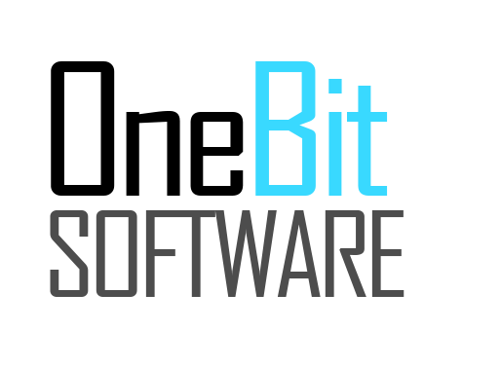


SoftUni Organizational Partners

Slide 38




Trainings @ Software University (SoftUni)
Software University – High-Quality Education and Employment Opportunities
softuni.bg
Software University Foundation
http://softuni.foundation/
Software University @ Facebook
facebook.com/SoftwareUniversity
Software University Forums
forum.softuni.bg
Notes:
© Software University Foundation – http://softuni.org
This work is licensed under the Creative Commons Attribution-NonCommercial-ShareAlike license.
<number>

Slide 39

License
This course (slides, examples, demos, videos, homework, etc.) is licensed under the "Creative Commons Attribution-NonCommercial-ShareAlike 4.0 International" license
<number>
Notes:
© Software University Foundation – http://softuni.org
This work is licensed under the Creative Commons Attribution-NonCommercial-ShareAlike license.
<number>

